Slide 1
Graph Data Structure

Slide 2
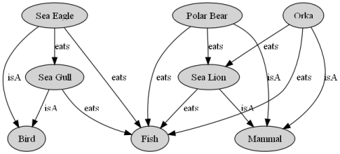
What is a graph?
A data structure that consists of a set of nodes (vertices) and a set of edges that relate the nodes to each other.
The set of edges describes relationships among the vertices.

Slide 3
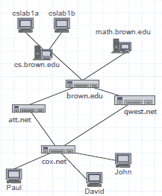
Applications
Computer networks
Local area network
Wide area network
Internet
Databases
Entity-relationship diagram

Slide 4
Applications
Transportation networks
Highway network
Flight network
JFK
LAX
LAX
STL
HNL
DFW
FTL

Slide 5
Other Applications
In Computer science graphs are used to represent the flow of computation.
Google maps uses graphs for building transportation systems, where intersection of two(or more) roads are considered to be a vertex and the road connecting two vertices is considered to be an edge, thus their navigation system is based on the algorithm to calculate the shortest path between two vertices.
In Facebook, users are considered to be the vertices and if they are friends then there is an edge running between them. Facebook’s Friend suggestion algorithm uses graph theory. Facebook is an example of undirected graph.
In World Wide Web, web pages are considered to be the vertices. There is an edge from a page u to other page v if there is a link of page v on page u. This is an example of Directed graph. It was the basic idea behind Google Page Ranking Algorithm.
In Operating System, we come across the Resource Allocation Graph where each process and resources are considered to be vertices. Edges are drawn from resources to the allocated process, or from requesting process to the requested resource. If this leads to any formation of a cycle then a deadlock will occur.

Slide 6
Graphs
Graph G = (V, E)
V = set of vertices
E = set of edges ⊆ (V×V)
Types of graphs
Undirected: edge (u, v) = (v, u); for all v, (v, v) ∉ E (No self loops.)
Directed: (u, v) is edge from u to v, denoted as u → v. Self loops are allowed.
Weighted: each edge has an associated weight, given by a weight function w : E → R.
Dense: |E| ≈ |V|².
Sparse: |E| << |V|²

Slide 7
Graphs
If (u, v) ∈ E, then vertex v is adjacent to vertex u.
Adjacency relationship is:
Symmetric if G is undirected.
Not necessarily so if G is directed.
If G is connected:
There is a path between every pair of vertices.

Slide 8
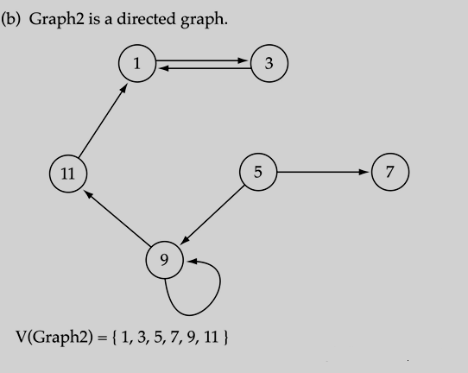
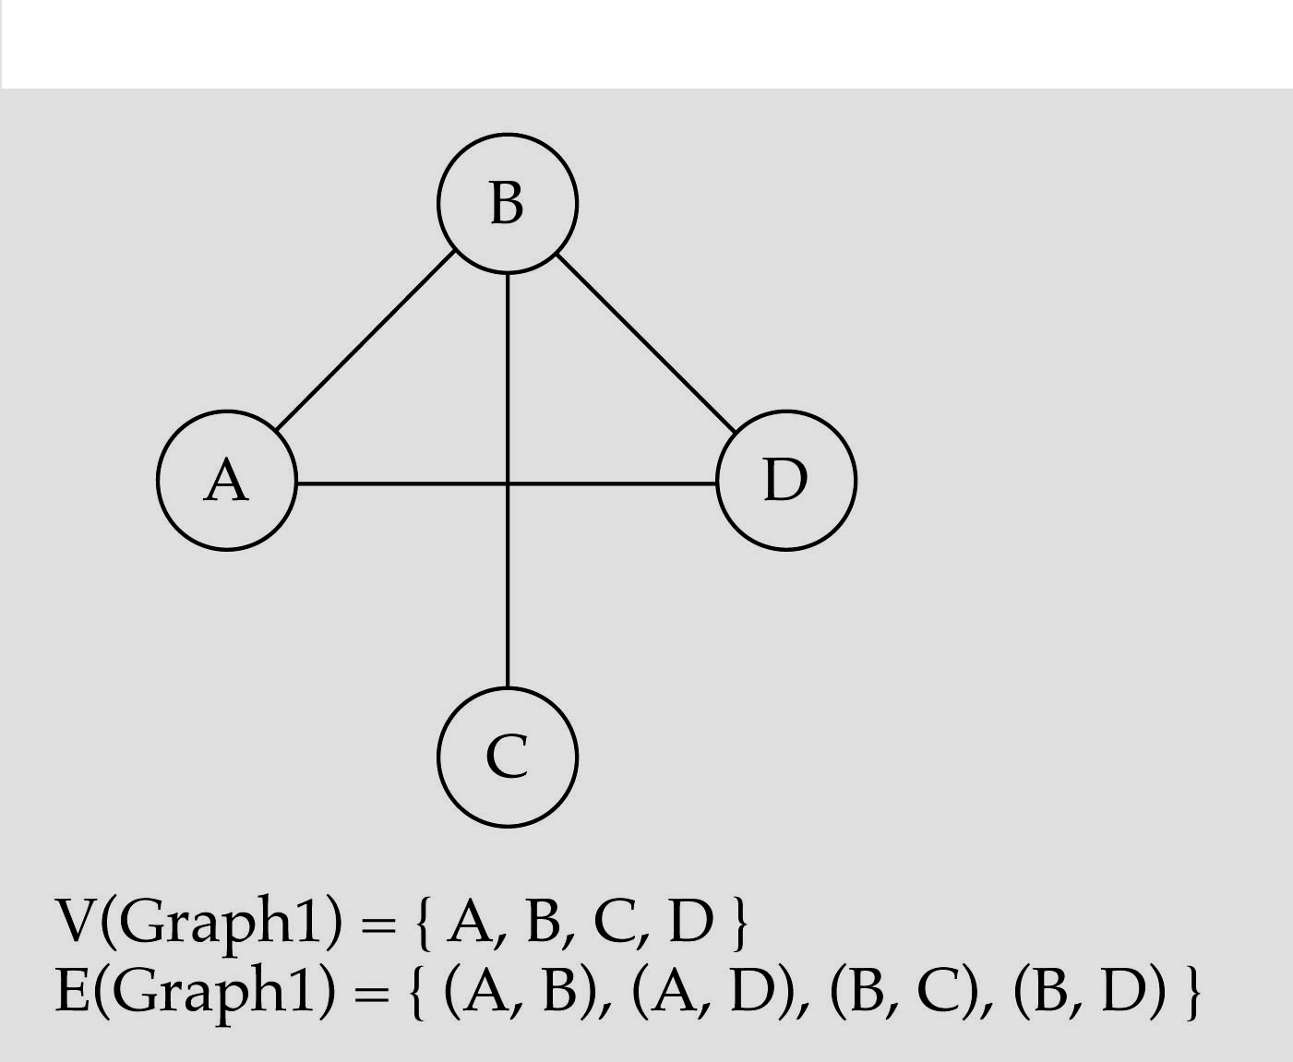
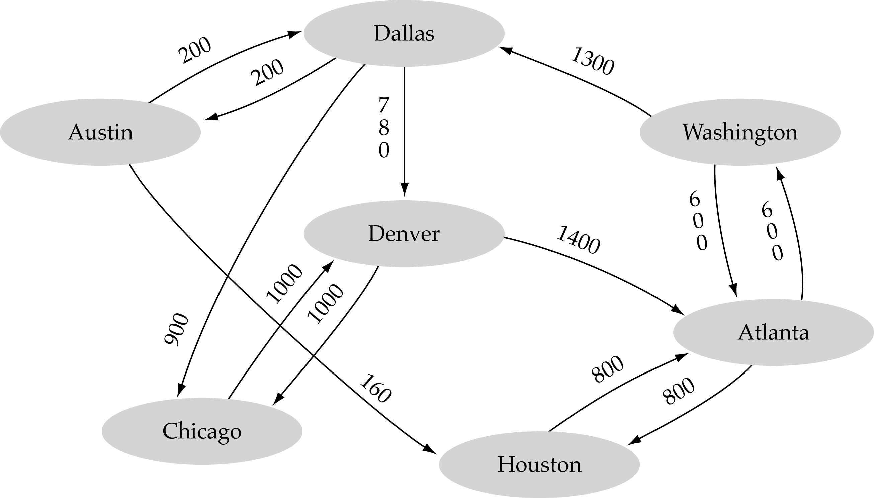
Classification
Graphs can be classified as:
Directed graphs
Undirected graphs
Weighted graphs

Slide 9
Graph Terminologies
Cycle
simple path, except that the last vertex is the same as the first vertex
Acyclic Graph
A graph without cycle is called acyclic Graph. A tree is a good example of acyclic graph.
a
b
c
d
e
a b e c a

Slide 10
Graph Terminologies
Connected Graph
An undirected graph is connected if, for any pair of vertices, there is a path between them.
A directed graph is connected if, for any pair of vertices, there is a path between them.
Connected
Not Connected

Slide 11
Graph Terminologies
Complete Graph
A graph in which all pairs of vertices are adjacent OR
A graph in which every vertex is directly connected to every other vertex
Let n = Number of vertices, and m = Number of edges
For a complete graph with n vertices, the number of edges is n(n – 1)/2. A graph with 6 vertices needs 15 edges to be complete.

Slide 12
Graph Terminologies
Degree of a node
In an Undirected graph, the total number of edges linked to a node is called a degree of that node.
For directed graph there are two degree for every node
Indegree
The indegree of a node is the total number of edges coming to that node.
Outdegree
The outdegree of a node is the total number of edges going out from that node

Slide 13
Graph Terminologies
3
0
0
2
1
2
3
1
2
3
3
3
G
3
4
5
6
3
3
0
in:1, out: 1
1
1
1
1
Directed graph
G2
in-degree
out-degree
1
in: 1, out: 2
2
in: 1, out: 0
G3

Slide 14
Representation of Graphs
Two standard ways.
Adjacency Lists.
Adjacency Matrix.
a
b
a
b
d
c
b
a
c
c
d
c
d
a
b
d
a
c
1
2
1 2 3 4
1 0 1 1 1
2 1 0 1 0
3 1 1 0 1
4 1 0 1 0
a
b
c
d
3
4

Slide 15
Adjacency Lists
Consists of an array Adj of |V| lists.
One list per vertex.
For u ∈ V, Adj[u] consists of all vertices adjacent to u.
a
b
a
b
d
c
b
c
If weighted, store weights also in adjacency lists.
c
d
c
d
d
a
b
a
b
d
c
b
a
c
c
d
c
d
a
b
d
a
c

Slide 16
Storage Requirement
For directed graphs:
Sum of lengths of all adj. lists is
∑out-degree(v) = |E|
^{v∈V}
Total storage: Θ(V+E)
For undirected graphs:
Sum of lengths of all adj. lists is
∑degree(v) = 2|E|
^{v∈V}
Total storage: Θ(V+E)
No. of edges leaving v
No. of edges incident on v. Edge (u,v) is incident on vertices u and v.

Slide 17
Pros and Cons: adj list
Pros
Space-efficient
Cons
Determining if an edge (u,v) ∈G is not efficient.
Have to search in u’s adjacency list. Θ(degree(u)) time.
Θ(V) in the worst case.

Slide 18
Adjacency Matrix
|V| × |V| matrix A.
Number vertices from 1 to |V| in some arbitrary manner.
A is then given by:
1
2
1 2 3 4
1 0 1 1 1
2 0 0 1 0
3 0 0 0 1
4 0 0 0 0
a
b
c
d
4
3
1
2
1 2 3 4
1 0 1 1 1
2 1 0 1 0
3 1 1 0 1
4 1 0 1 0
a
b
c
d
3
4

Slide 19
Space and Time
Space: Θ(V²).
Not memory efficient for large graphs.
Time: to list all vertices adjacent to u: Θ(V).
Time: to determine if (u, v) ∈ E: Θ(1).
Can store weights instead of bits for weighted graph.

Slide 20
Graph-searching Algorithms
Searching a graph:
Systematically follow the edges of a graph to visit the vertices of the graph.
Used to discover the structure of a graph.
Standard graph-searching algorithms.
Breadth-first Search (BFS).
Depth-first Search (DFS).

Slide 21
Breadth-first Search
Input: Graph G = (V, E), either directed or undirected, and source vertex s ∈ V.
Output:
d[v] = distance (smallest # of edges, or shortest path) from s to v, for all v ∈ V. d[v] = ∞ if v is not reachable from s.
π[v] = u such that (u, v) is last edge on shortest path s v.
u is v’s predecessor.
Builds breadth-first tree with root s that contains all reachable vertices.

Slide 22
Breadth-first Search
Expands the frontier between discovered and undiscovered vertices uniformly across the breadth of the frontier.
A vertex is “discovered” the first time it is encountered during the search.
A vertex is “finished” if all vertices adjacent to it have been discovered.
Colors the vertices to keep track of progress.
White – Undiscovered.
Gray – Discovered but not finished.
Black – Finished.
Colors are required only to reason about the algorithm. Can be implemented without colors.

Slide 23
BFS for Shortest Paths
2
3
3
2
2
3
1
S
S
S
2
1
1
2
2
3
3
Finished
Discovered
Undiscovered

Slide 24
BFS(G,s)
1. for each vertex u in V[G] – {s}
2 do color[u] ← white
3 d[u] ← ∝
4 π[u] ← nil
5 color[s] ← gray
6 d[s] ← 0
7 π[s] ← nil
8 Q ← Φ
9 enqueue(Q,s)
10 while Q ≠ Φ
11 do u ← dequeue(Q)
12 for each v in Adj[u]
13 do if color[v] = white
14 then color[v] ← gray
15 d[v] ← d[u] + 1
16 π[v] ← u
17 enqueue(Q,v)
18 color[u] ← black
white: undiscovered
gray: discovered
black: finished
Q: a queue of discovered vertices
color[v]: color of v
d[v]: distance from s to v
π[u]: predecessor of v
Example: animation.

Slide 25
Example (BFS)
r
s
t
u
∞
0
∞
∞
∞
∞
∞
∞
v
w
x
y
Q: s
0

Slide 26
Example (BFS)
r
s
t
u
1
0
∞
∞
∞
1
∞
∞
v
w
x
y
Q: w r
1 1

Slide 27
Example (BFS)
r
s
t
u
1
0
2
∞
∞
1
2
∞
v
w
x
y
Q: r t x
1 2 2

Slide 28
Example (BFS)
r
s
t
u
1
0
2
∞
2
1
2
∞
v
w
x
y
Q: t x v
2 2 2

Slide 29
Example (BFS)
r
s
t
u
1
0
2
3
2
1
2
∞
v
w
x
y
Q: x v u
2 2 3

Slide 30
Example (BFS)
r
s
t
u
1
0
2
3
2
1
2
3
v
w
x
y
Q: v u y
2 3 3

Slide 31
Example (BFS)
r
s
t
u
1
0
2
3
2
1
2
3
v
w
x
y
Q: u y
3 3

Slide 32
Example (BFS)
r
s
t
u
1
0
2
3
2
1
2
3
v
w
x
y
Q: y
3

Slide 33
Example (BFS)
r
s
t
u
1
0
2
3
2
1
2
3
v
w
x
y
Q: ∅

Slide 34
Example (BFS)
r
s
t
u
1
0
2
3
2
1
2
3
v
w
x
y
BF Tree

Slide 35
Analysis of BFS
Initialization takes O(V).
Traversal Loop
After initialization, each vertex is enqueued and dequeued at most once, and each operation takes O(1). So, total time for queuing is O(V).
The adjacency list of each vertex is scanned at most once. The sum of lengths of all adjacency lists is Θ(E).
Summing up over all vertices => total running time of BFS is O(V+E), linear in the size of the adjacency list representation of graph.

Slide 36
Depth-first Search (DFS)
Explore edges out of the most recently discovered vertex v.
When all edges of v have been explored, backtrack to explore other edges leaving the vertex from which v was discovered (its predecessor).
“Search as deep as possible first.”
Continue until all vertices reachable from the original source are discovered.
If any undiscovered vertices remain, then one of them is chosen as a new source and search is repeated from that source.

Slide 37
Depth-first Search
Input: G = (V, E), directed or undirected. No source vertex given!
Output:
2 timestamps on each vertex. Integers between 1 and 2|V|.
d[v] = discovery time (v turns from white to gray)
f [v] = finishing time (v turns from gray to black)
π[v] : predecessor of v = u, such that v was discovered during the scan of u’s adjacency list.
Uses the same coloring scheme for vertices as BFS.

Slide 38
Pseudo-code
DFS(G)
1. for each vertex u ∈ V[G]
2. do color[u] ← white
3. π[u] ← NIL
4. time ← 0
5. for each vertex u ∈ V[G]
6. do if color[u] = white
7. then DFS-Visit(u)
DFS-Visit(u)
color[u] ← GRAY ∇ White vertex u has been discovered
time ← time + 1
d[u] ← time
for each v ∈ Adj[u]
do if color[v] = WHITE
then π[v] ← u
DFS-Visit(v)
color[u] ← BLACK ∇ Blacken u; it is finished.
f[u] ← time ← time + 1
Example: animation.

Slide 39
Example (DFS)
u
v
w
1/
x
y
z

Slide 40
Example (DFS)
u
v
w
1/
2/
x
y
z

Slide 41
Example (DFS)
u
v
w
1/
2/
3/
x
y
z

Slide 42
Example (DFS)
u
v
w
1/
2/
4/
3/
x
y
z

Slide 43
Example (DFS)
u
v
w
1/
2/
B
4/
3/
x
y
z

Slide 44
Example (DFS)
u
v
w
1/
2/
B
4/5
3/
x
y
z

Slide 45
Example (DFS)
u
v
w
1/
2/
B
4/5
3/6
x
y
z

Slide 46
Example (DFS)
u
v
w
1/
2/7
B
4/5
3/6
x
y
z

Slide 47
Example (DFS)
u
v
w
1/
2/7
F
B
4/5
3/6
x
y
z

Slide 48
Example (DFS)
u
v
w
1/8
2/7
F
B
4/5
3/6
x
y
z

Slide 49
Example (DFS)
u
v
w
1/8
2/7
9/
F
B
4/5
3/6
x
y
z

Slide 50
Example (DFS)
u
v
w
1/8
2/7
9/
F
B
C
4/5
3/6
x
y
z

Slide 51
Example (DFS)
u
v
w
1/8
2/7
9/
F
B
C
4/5
3/6
10/
x
y
z

Slide 52
Example (DFS)
u
v
w
1/8
2/7
9/
F
B
C
4/5
3/6
10/
B
x
y
z

Slide 53
Example (DFS)
u
v
w
1/8
2/7
9/
F
B
C
4/5
3/6
10/11
B
x
y
z

Slide 54
Example (DFS)
u
v
w
1/8
2/7
9/12
F
B
C
4/5
3/6
10/11
B
x
y
z

Slide 55
Analysis of DFS
Loops on lines 1-2 & 5-7 take Θ(V) time, excluding time to execute DFS-Visit.
DFS-Visit is called once for each white vertex v∈V when it’s painted gray the first time. Lines 3-6 of DFS-Visit is executed |Adj[v]| times. The total cost of executing DFS-Visit is ∑_{v∈V}|Adj[v]| = Θ(E)
Total running time of DFS is Θ(V+E).

Slide 56
Finding Shortest Path
In graph theory, the shortest path problem is the problem of finding a path between two vertices (or nodes) in a graph such that the sum of the weights of its constituent edges is minimized.

Slide 57
Minimum spanning tree
Given a connected and undirected graph, a spanning tree of that graph is a subgraph that is a tree and connects all the vertices together.
A single graph can have many different spanning trees. A minimum spanning tree (MST) or minimum weight spanning tree for a weighted, connected and undirected graph is a spanning tree with weight less than or equal to the weight of every other spanning tree.
The weight of a spanning tree is the sum of weights given to each edge of the spanning tree.

Slide 58
How many edges does a minimum spanning tree has?
A minimum spanning tree has (V – 1) edges where V is the number of vertices in the given graph.

Slide 59
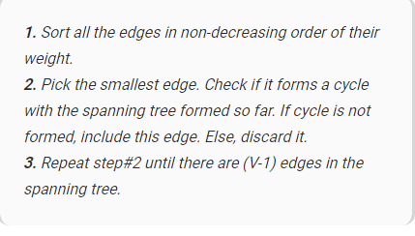
Kruskal’s Minimum spanning tree
Below are the steps for finding MST using Kruskal’s algorithm

Slide 60
Cont….
The algorithm is a Greedy Algorithm. The Greedy Choice is to pick the smallest weight edge that does not cause a cycle in the MST constructed so far.

Slide 61
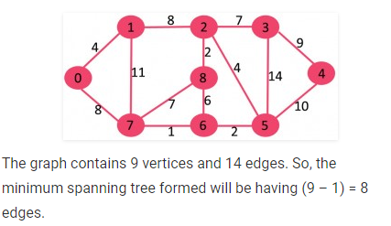
Example

Slide 62
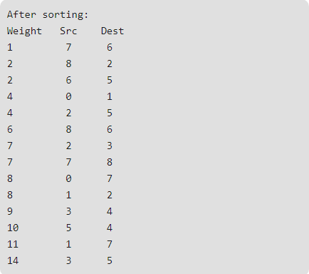
Example

Slide 63
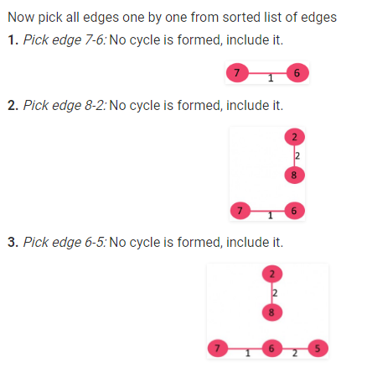
Example

Slide 64
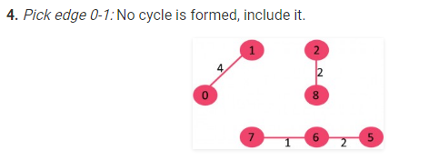
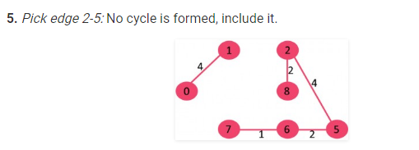
Example

Slide 65
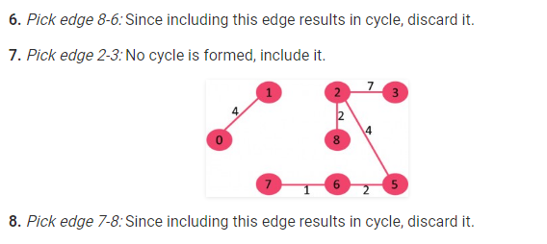
Example

Slide 66
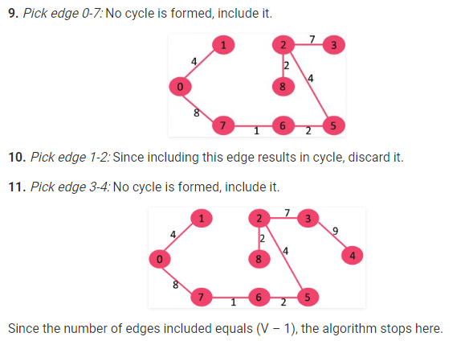
Example

